Slide 1

....
Environmental monitoring

Slide 2
Name:s.samson Reg no:422621106029
Introduction:
describes the processes and activities that need to take place to characterize and monitor the quality of the environment. Environmental monitoring is used in the preparation of environmental impact assessments, as well as in many circumstances in which human activities carry a risk of harmful effects on the natural environment. All monitoring strategies and programs have reasons and justifications which are often designed to establish the current status of an environment or to establish trends in environmental parameters. In all cases, the results of monitoring will be reviewed, analyzed statistically, and published. The design of a monitoring program must therefore have regard to the final use of the data before monitoring starts. Environmental monitoring includes monitoring of air quality, soils and water quality.

Slide 3
Humidity monitoring
Humidity is the concentration of water vapor present in the air. Water vapor, the gaseous state of water, is generally invisible to the human eye.[2] Humidity indicates the likelihood for precipitation, dew, or fog to be present.Humidity depends on the temperature and pressure of the system of interest. The same amount of water vapor results in higher relative humidity in cool air than warm air. A related parameter is the dew point. The amount of water vapor needed to achieve saturation increases as the temperature increases.

Slide 4
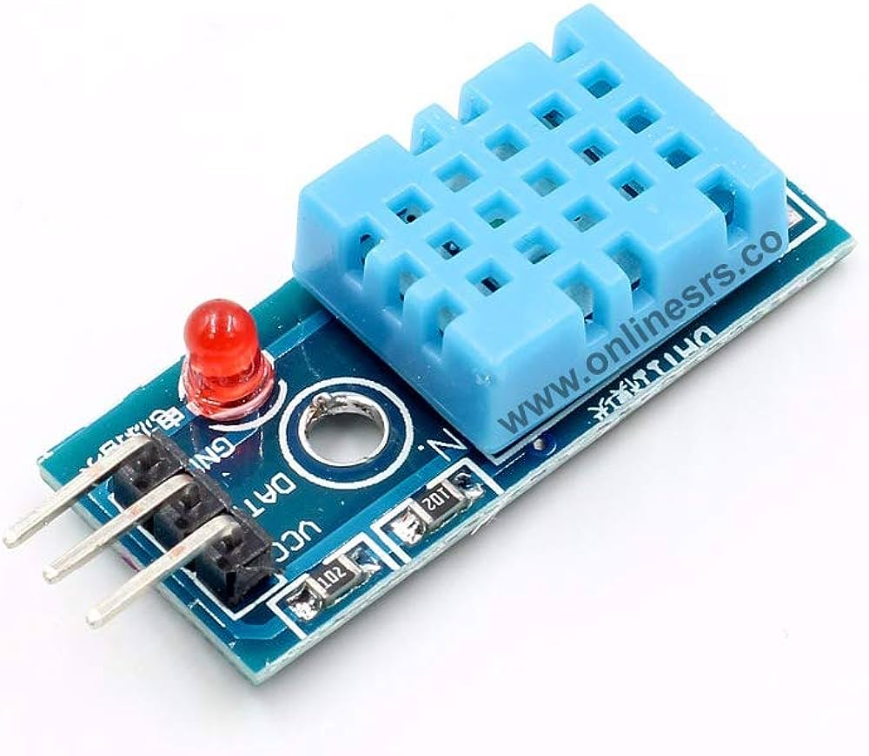
Humidity sensor

Slide 5
......
#include <dht11.h>
#define DHT11PIN 4
dht11 DHT11;
void setup()
{
Serial.begin(9600);
}
void loop()
{
Serial.println();
int chk = DHT11.read(DHT11PIN);
Serial.print("Humidity (%): ");
Serial.println((float)DHT11.humidity, 2);

Slide 6
… .
Serial.print("Temperature (C): ");
Serial.println((float)DHT11.temperature, 2);
delay(2000);
}

Slide 7
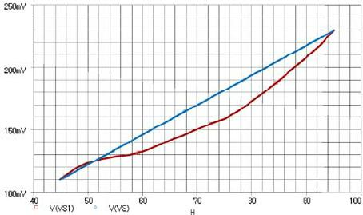
Output:

Slide 8
Temperature:
Introduction:
Temperature is a physical quantity that expresses quantitatively the attribute of hotness or coldness. Temperature is measured with a thermometer. It relects the kinetic energy of the vibrating and colliding atoms making up a substance. Thermometers are calibrated in various temperature scales that historically have relied on various reference points and thermometric substances for definition. The most common scales are the Celsius scale with the unit symbol °C (formerly called centigrade), the Fahrenheit scale (°F), and the Kelvin scale (K), the latter being used predominantly for scientific purposes. The kelvin is one of the seven base units in the Internation

Slide 9
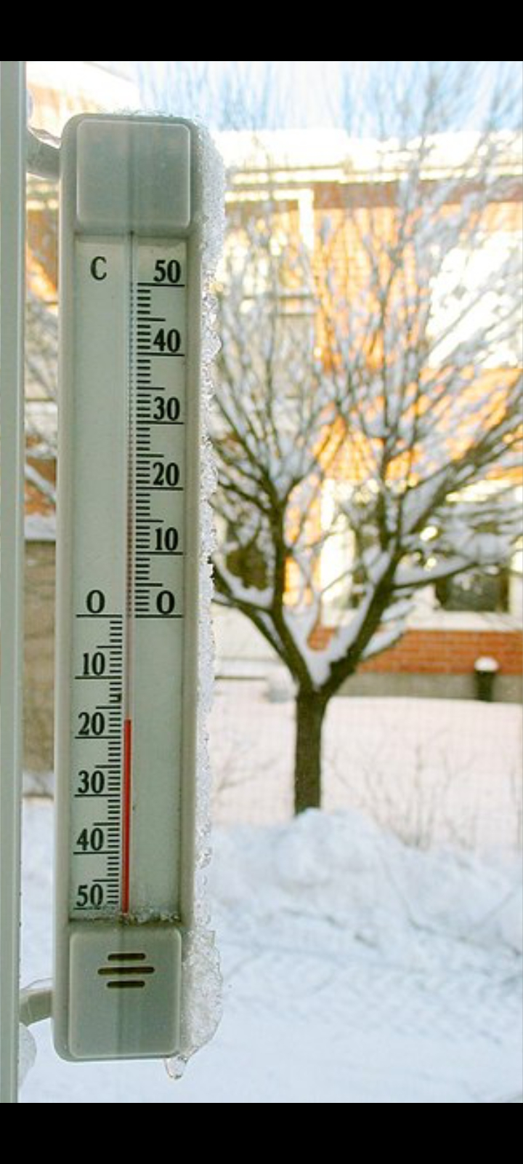
Temperature sensor

Slide 10
Temperature source coding:
float temp;
int tempPin = 0;
void setup() {
Serial.begin(9600);
}
void loop() {
temp = analogRead(tempPin);
// read analog volt from sensor and
save to variable temp
temp = temp * 0.48828125;

Slide 11
… …
// convert the analog volt to its
temperature equivalent
Serial.print("TEMPERATURE = ");
Serial.print(temp); // display
temperature value
Serial.print("*C");
Serial.println();
delay(1000); // update sensor reading
each one second

Slide 12
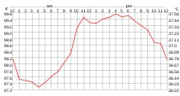
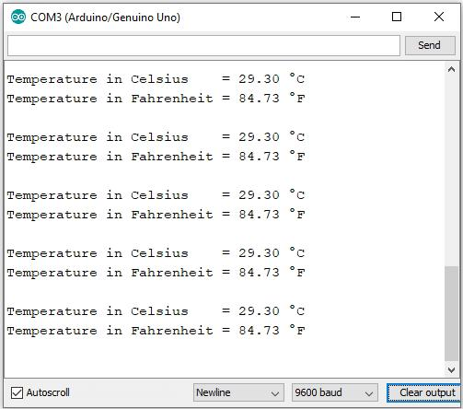
Temperature output:

Slide 13
Air monitoring:
Introduction:
Air pollutants are atmospheric substances—both naturally occurring and anthropogenic—which may potentially have a negative impact on the environment and organism health. With the evolution of new chemicals and industrial processes has come the introduction or elevation of pollutants in the atmosphere, as well as environmental research and regulations, increasing the demand for air quality monitoring.[1] Air quality monitoring is challenging to enact as it requires the effective integration of multiple environmental data sources, which often originate from different environmental networks and institutions.[2] These challenges require specialized observation equipment and tools to establish air pollutant concentrations, including sensor networks, geographic information system (GIS) models, and the Sensor Observation Service (SOS.

Slide 14
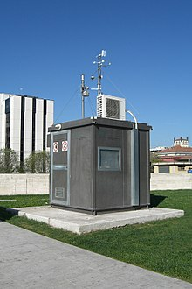
Air sensor

Slide 15
Air monitoring source coding:
#include <SPI.h>
#include <Wire.h>
#include <Adafruit_GFX.h>
#include <Adafruit_SSD1306.h>
#include <Fonts/FreeSans9pt7b.h>
#include <Fonts/FreeMonoOblique9pt7b.h>
#include <DHT.h>
#define SCREEN_WIDTH 128 // OLED display width, in pixels
#define SCREEN_HEIGHT 64 // OLED display height, in pixels1011
#define OLED_RESET 4 // Reset pin # (or -1 if sharing Arduino reset pin)Adafruit_SSD1306 display(SCREEN_WIDTH, SCREEN_HEIGHT, &Wire, OLED_RESET);#define sensor A0 15

Slide 16
… …
}8081void setup()
{
Serial.begin(9600);
pinMode(sensor,INPUT);
dht.begin();
if(!display.begin(SSD1306_SWITCHCAPVCC, 0x3c))
{ // Address 0x3D for 128x6486
Serial.println(F("SSD1306 allocation failed"));
}
display.clearDisplay();
display.setTextColor(WHITE); display.setTextSize(2);
display.setCursor(50, 0);

Slide 17
… .
display.println("Air");
display.setTextSize(1);
display.setCursor(23, 20);
display.println("Qulaity monitor");
display.display();
delay(1200);
display.clearDisplay();
display.setTextSize(2);
display.setCursor(20, 20);
display.println("BY Abid");
display.display();
delay(1000);
display.clearDisplay();
}

Slide 18
… ..
void loop() {
display.clearDisplay();
air_sensor();
sendSensor();
display

Slide 19
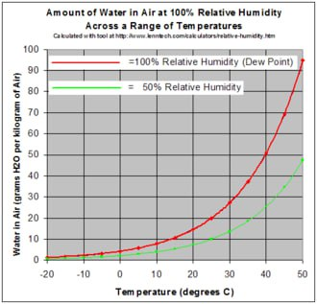
Air monitoring output

Slide 20
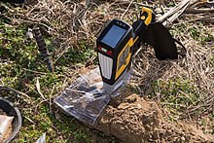
Soil monitoring:
Introduction:
Soil monitoring involves the collection and/or analysis of soil and its associated quality, constituents, and physical status to determine or guarantee its fitness for use. Soil faces many threats, including compaction, contamination, organic material loss, biodiversity loss, slope stability issues, erosion, salinization, and acidification. Soil monitoring helps characterize these threats and other potential risks to the soil, surrounding environments, animal health, and human health.

Slide 21
Soil monitoring source coding
const int sensor_pin = A1; /* Soil
moisture sensor O/P pin */
void setup() {
Serial.begin(9600); /* Define baud
rate for serial communication */}
void loop() {
float moisture_percentage;
int sensor_analog;
sensor_analog =
analogRead(sensor_pin);
moisture_percentage = ( 100 - ( (sensor_analog/1023.00) * 100 ) );
Serial.print("Moisture Percentage = ");

Slide 22
… .
Serial.print(moisture_percentage);
Serial.print("%\n\n");
delay(1000);
}

Slide 23
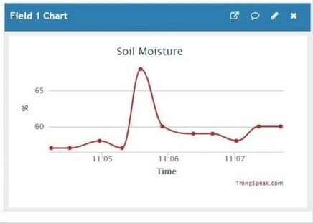
Soil monitoring output

Slide 24

.....

